Slide 1
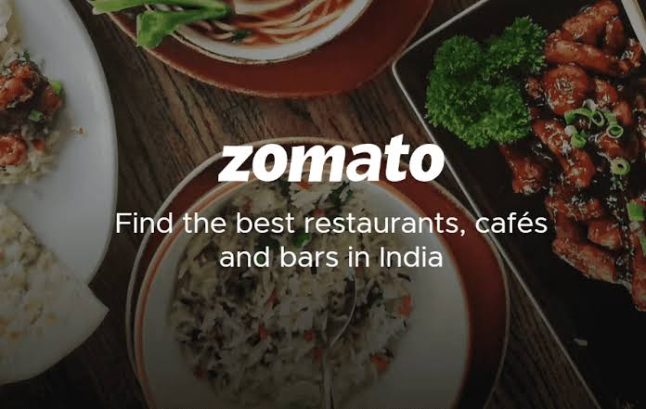

Slide 2
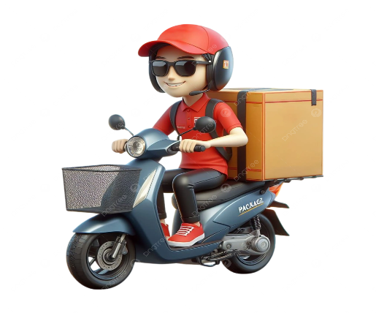

GROUP 4
1 Yukti Rajesh Nigde
2 Pradeep Kumar Roy Choudhury
3 Nikita
4 Yash Khandu Dongare
5 Tenzing Norphel Bhutia
6 MOLLI PARDHASARADHI
7 SHAIK FARHEEN

Slide 3
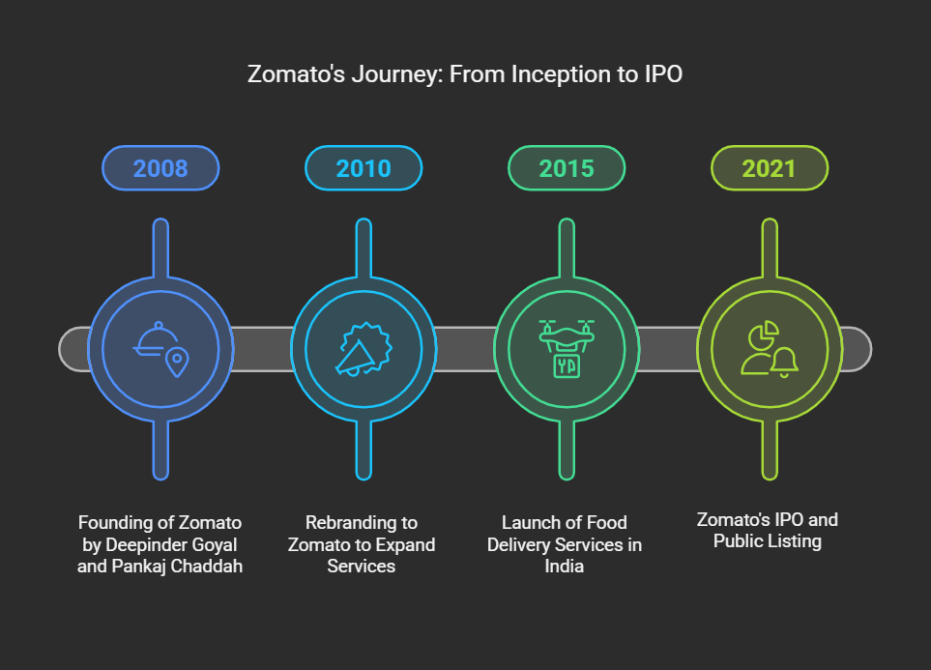
Zomato is an Indian company that provides online food delivery and restaurant services
Zomato offers users information about restaurants, cuisines, prices, and customer ratings.
Helps users make informed dining decisions.

Slide 4
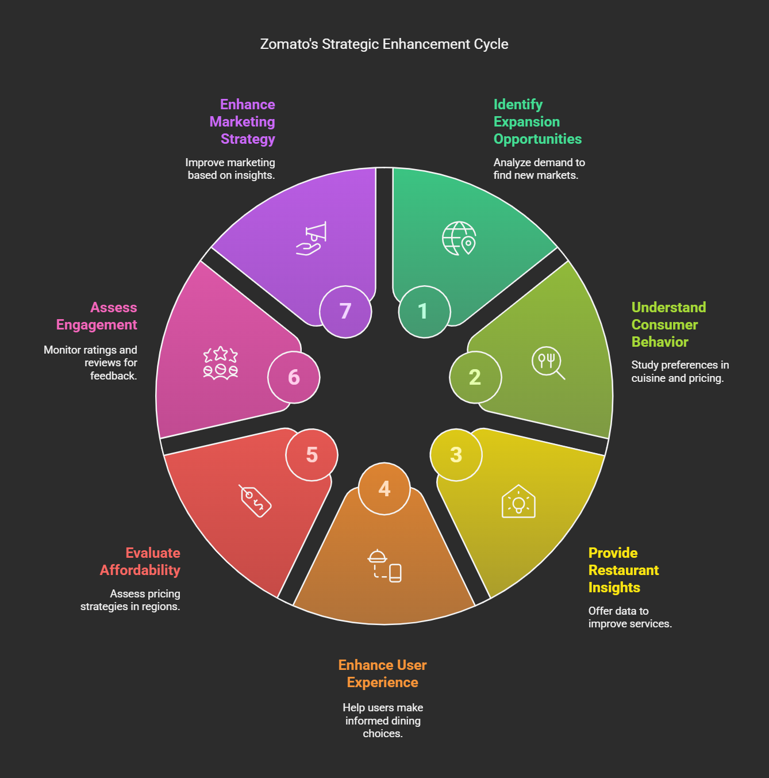
GOALS

Slide 5
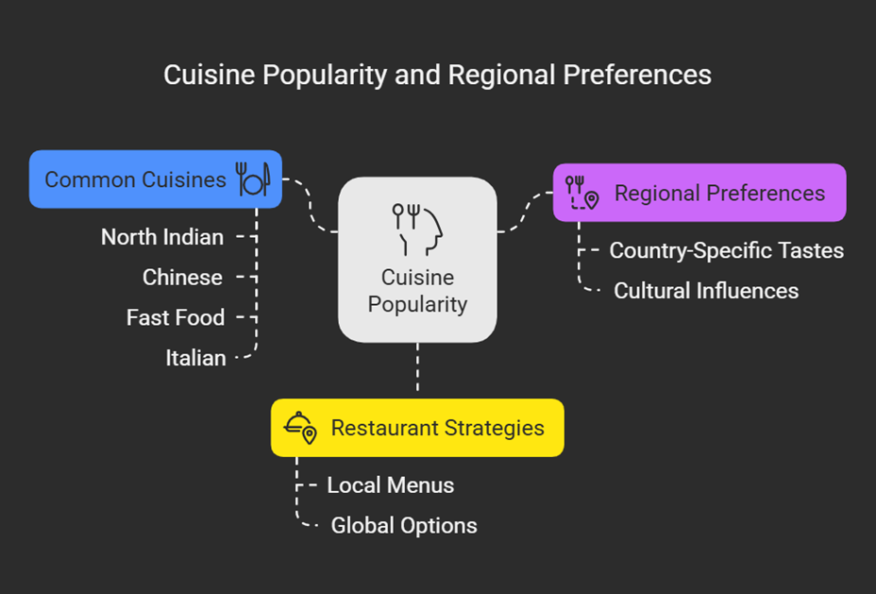
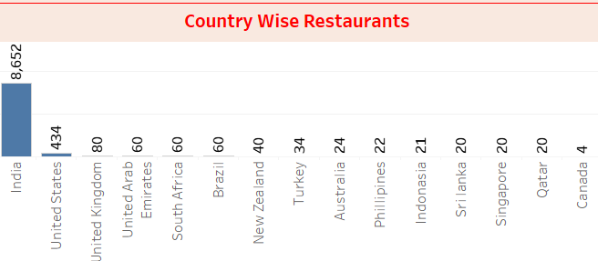
TOP Countries and Cuisines
India has the highest number of listed restaurants.
Other major contributors: Australia, Brazil, Canada, Indonesia.

Slide 6
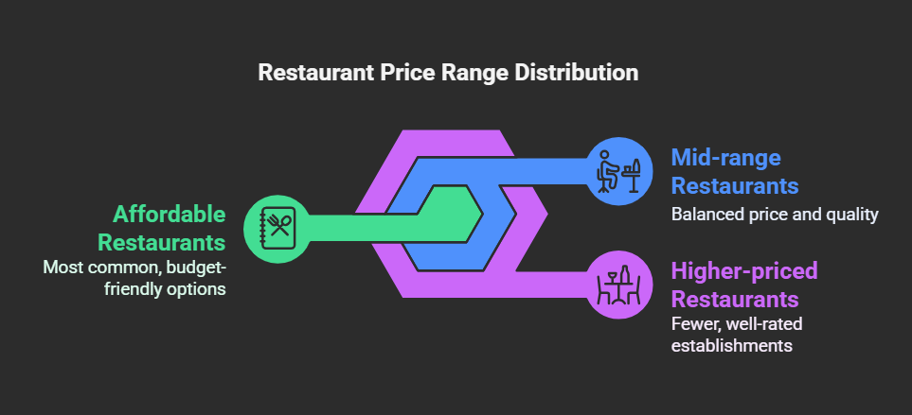
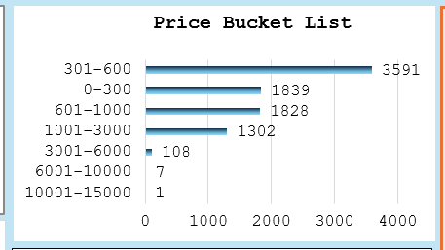
Most restaurants fall into the affordable range (₹200-₹1000 for two people).
Higher-priced restaurants are fewer but well-rated.

Slide 7
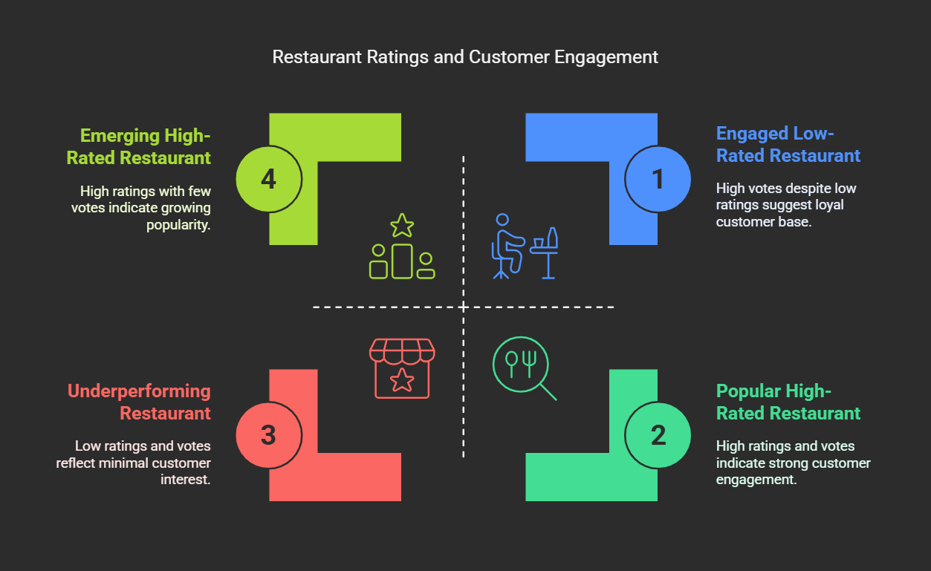

Slide 8
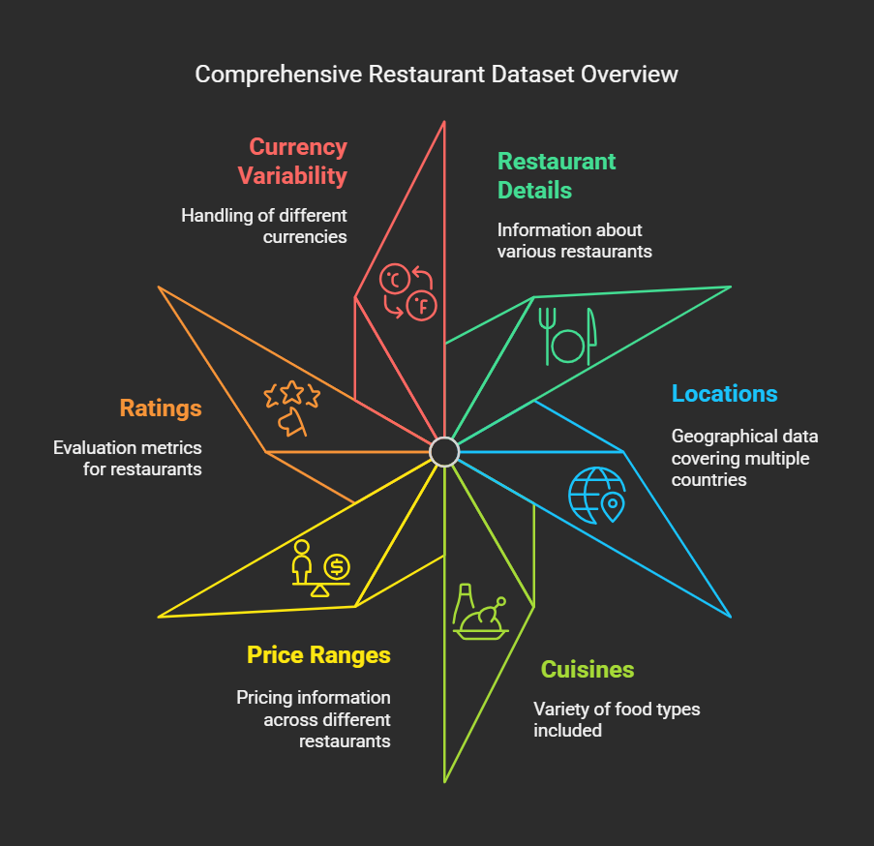

Slide 9
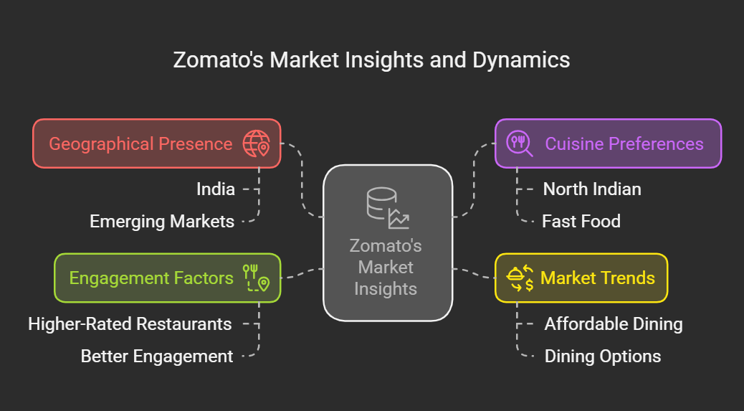
Conclusion : Zomato’s data offers valuable insights for restaurant owners and customers alike.

Slide 10

THANK YOU

